Slide 1
Ridge(L2) and Lasso(L1)
Pardeep Kumar

Slide 2
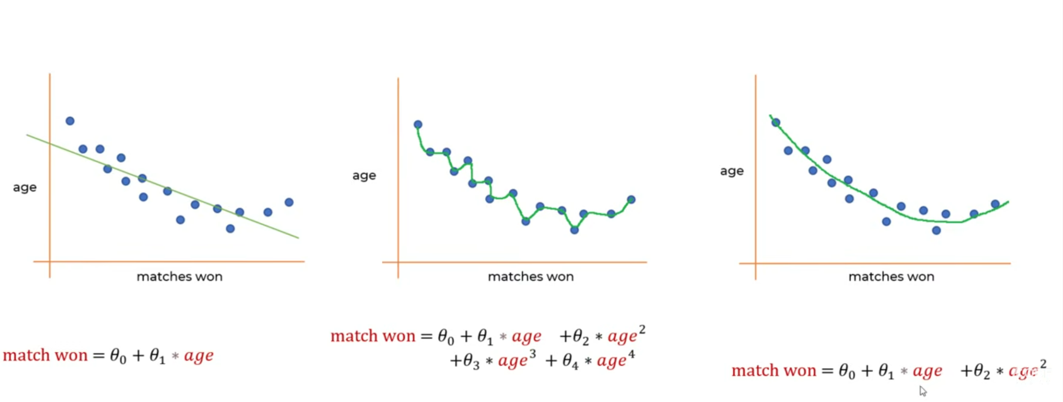

Slide 3
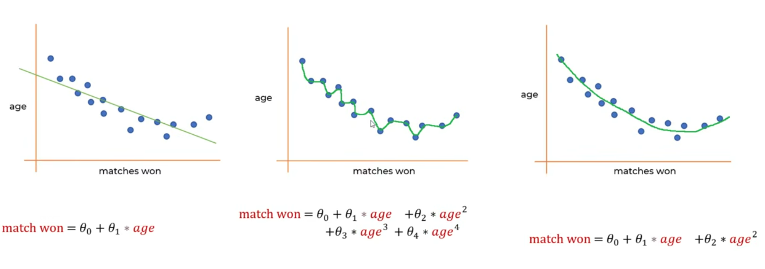

Slide 4


Slide 5
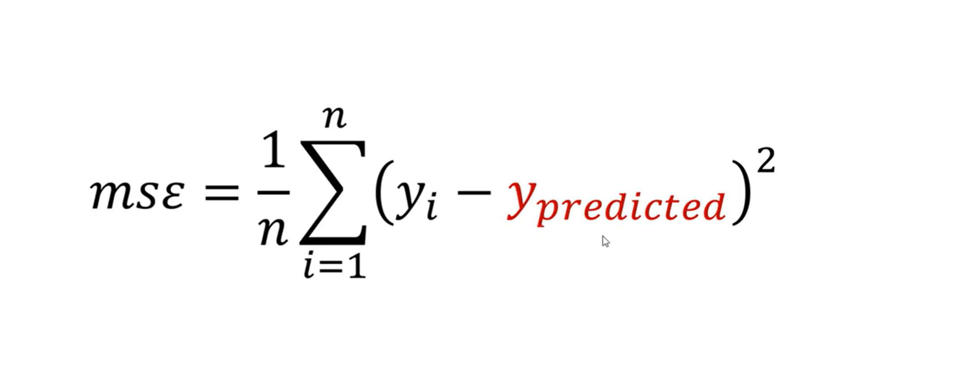

Slide 6
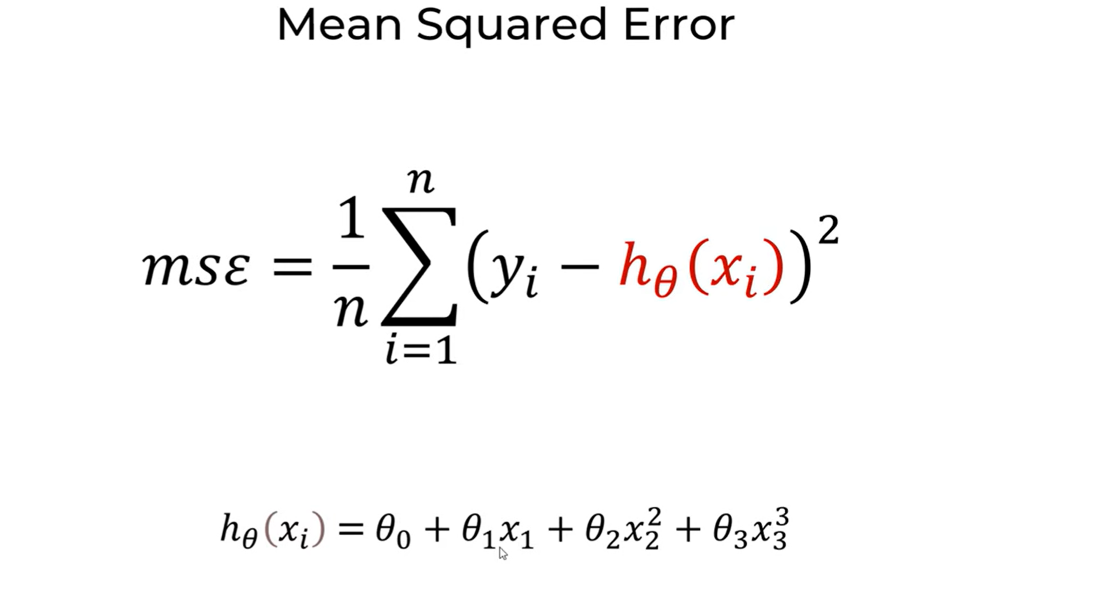

Slide 7
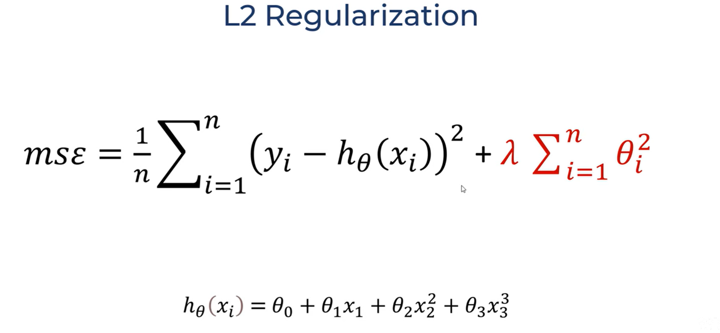

Slide 8
